Slide 1

Troubleshooting

Slide 2
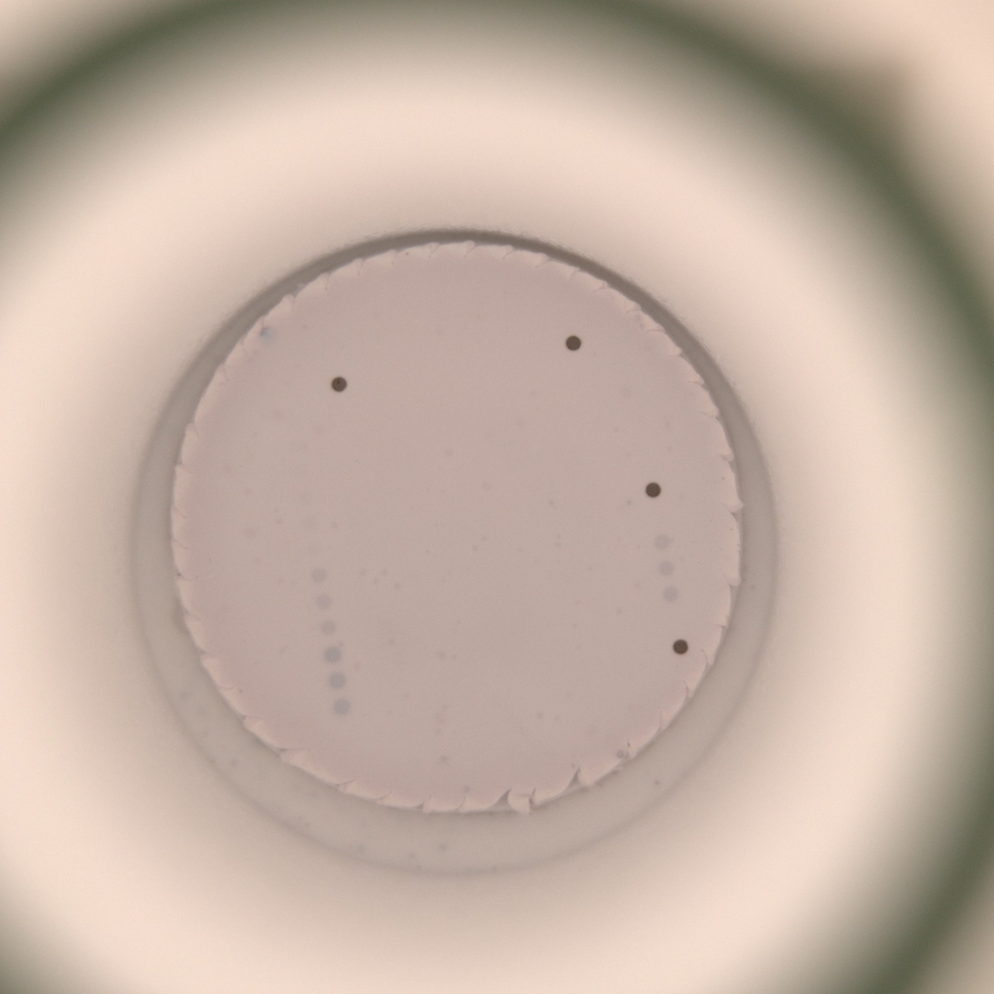
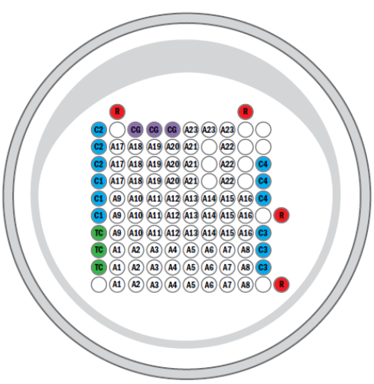
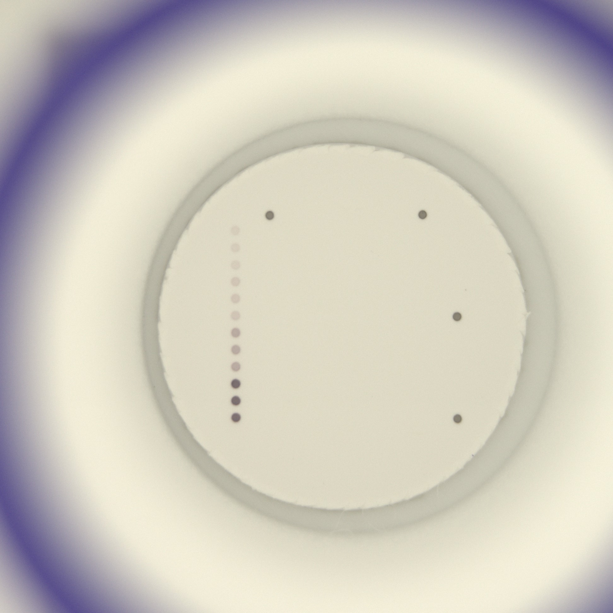
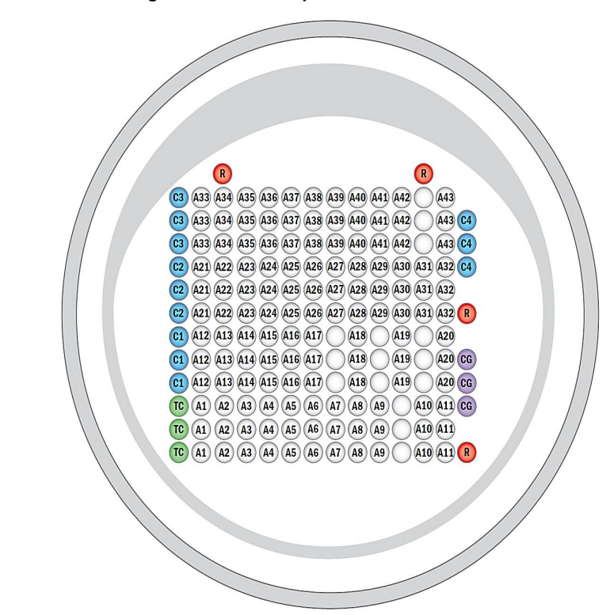
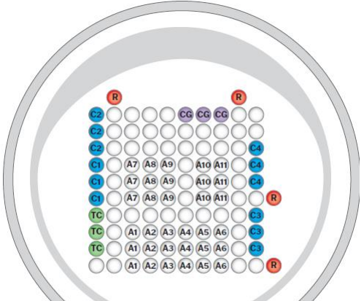
Borrelia IgG (CG)
Conjugate Control spots in triplet (CA/CG/CM) are missing
Borrelia IgG (CG)
Chlamydia IgG (CG)
ANA (CG)
Conjugate does not work
=>
TAKE A NEW CONJUGATE
Check if correct congujate is used
ANA (CG)
Chlamydia IgG (CG)

Slide 3
Test Control (TC) = Substrate Control spots in triplet are weak or missing
Conjugate control spots in triplet are weak or missing
Calibration spots in triplet are weak or missing
Substrate does not work
=>
TAKE A NEW SUBSTRATE

Slide 4
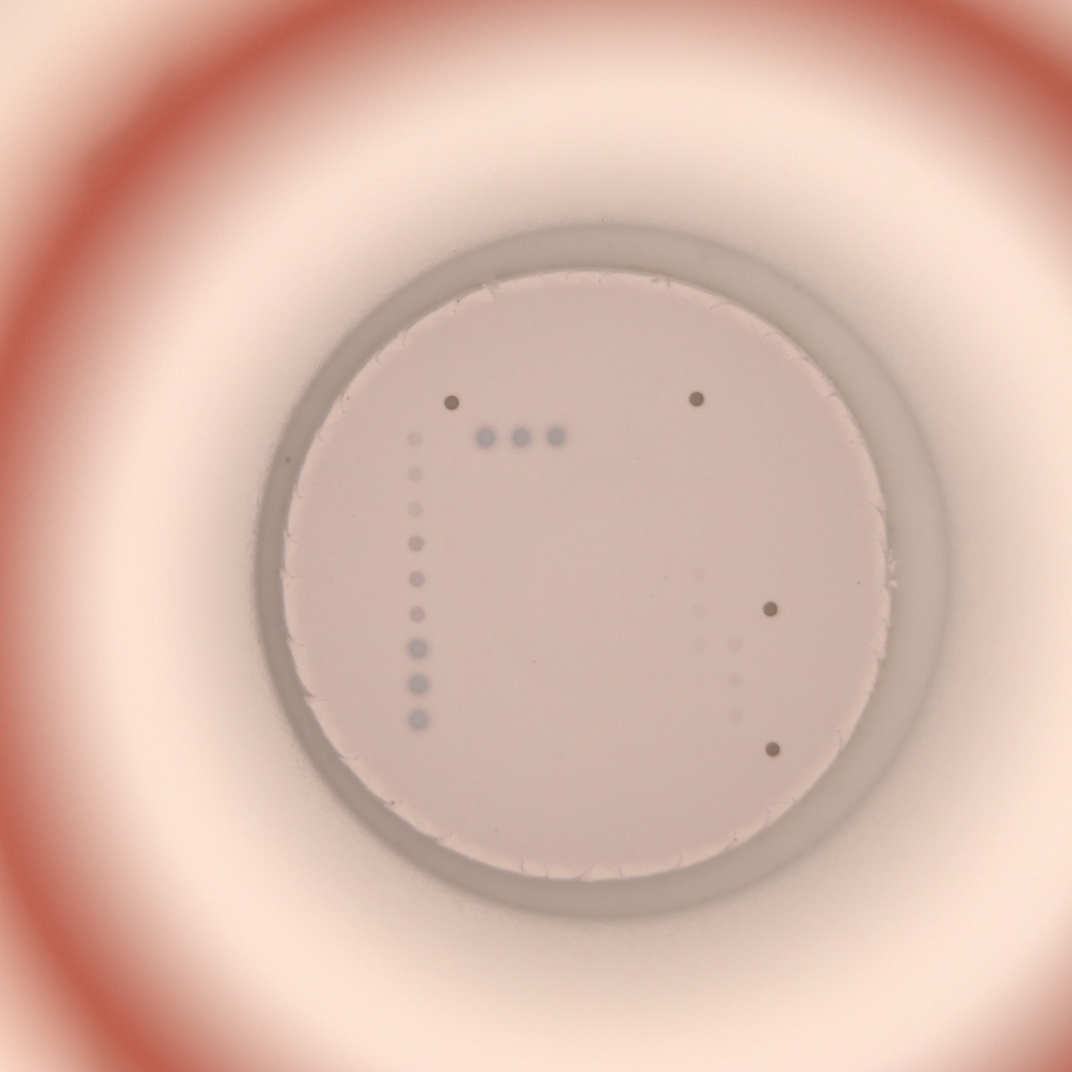
Test Control (TC) = Substrate Control spots in triplet are blurred
Conjugate control spots in triplet are blurred
Calibration spots in triplet are weak or missing
Substrate does not work
=>
TAKE A NEW SUBSTRATE

Slide 5
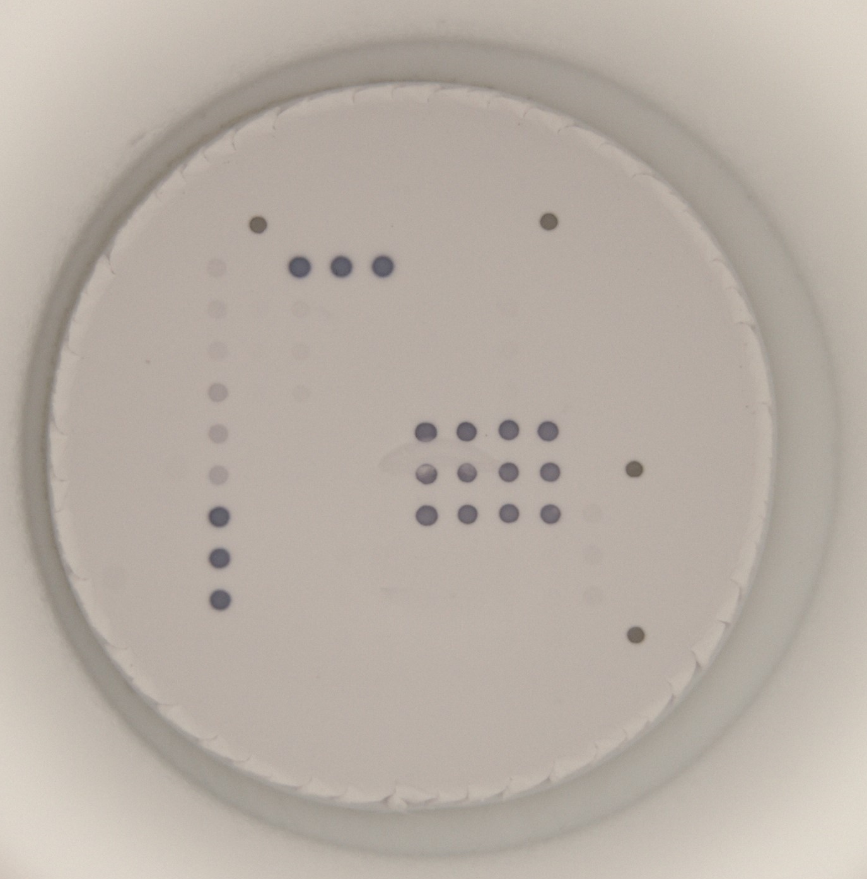
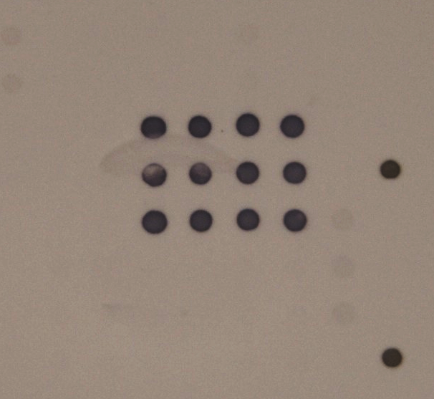
Needle print on micro-cellulose membrane from the washer can cause false positivity or destroy the membrane
=>
Adjust the hEight of wash needle properly
Insert the well into frame properly

Slide 6
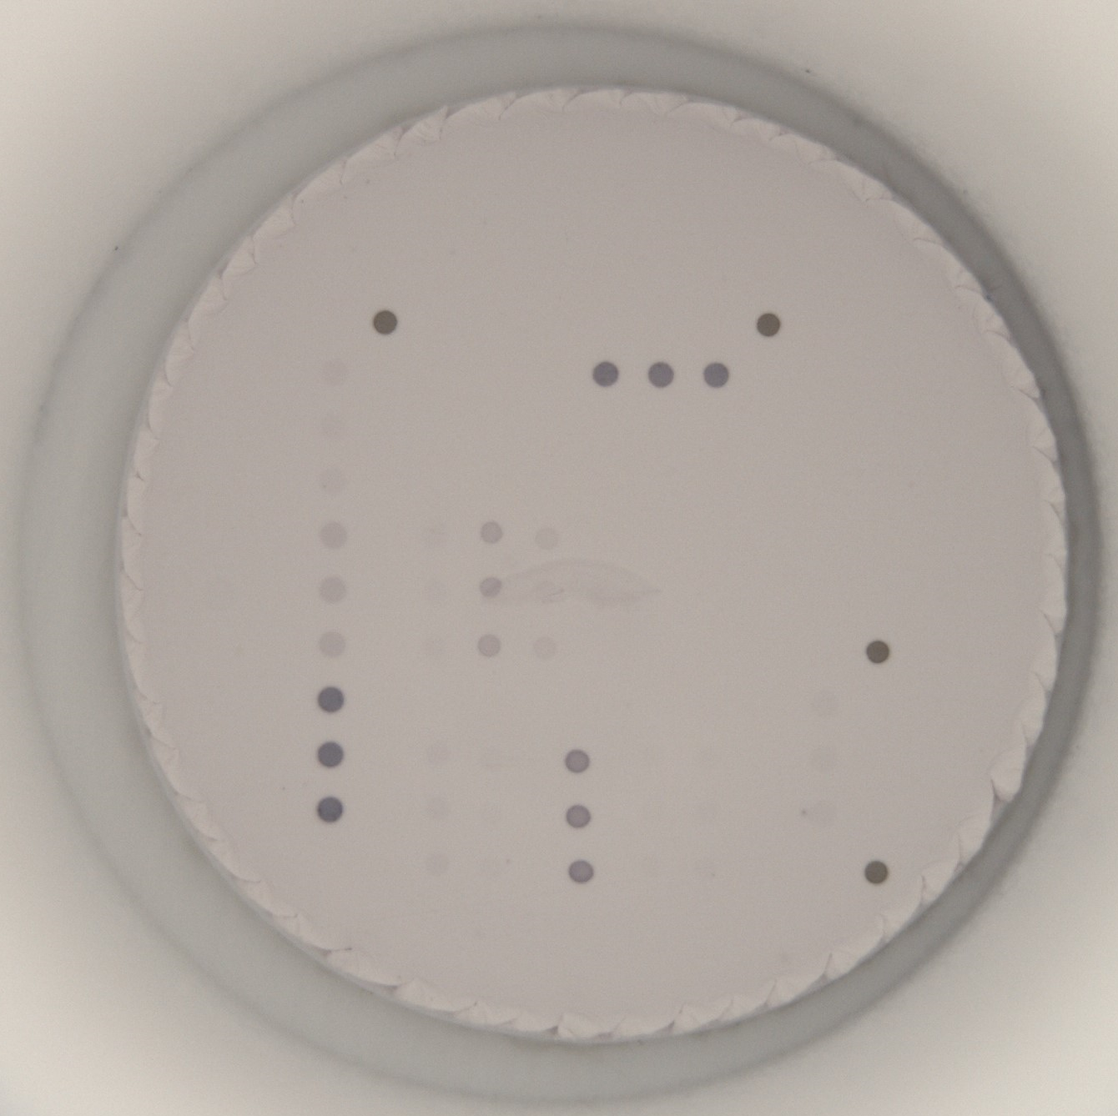
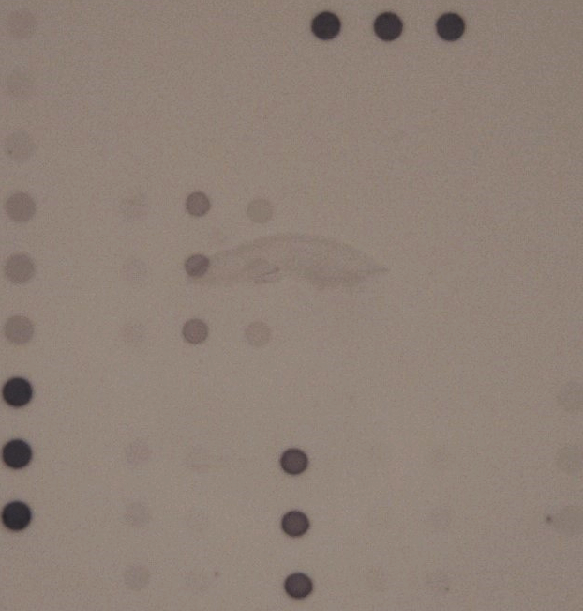
Needle print on micro-cellulose membrane from the washer can cause false positivity or destroy the membrane
=>
Adjust the hEight of wash needle properly
Insert the well into frame properly

Slide 7
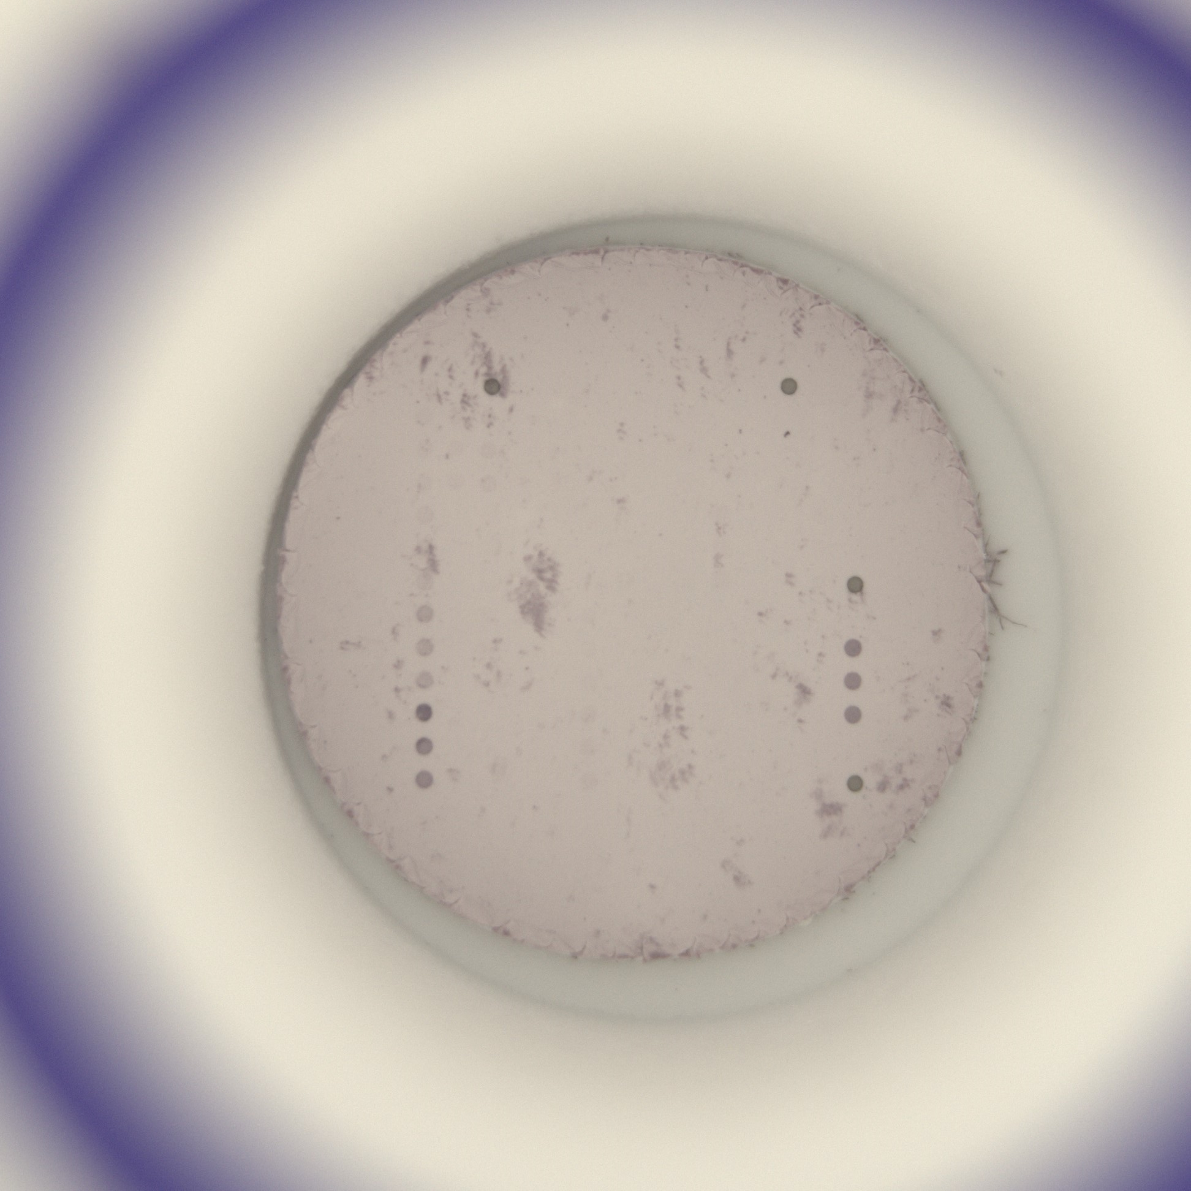
Impurities (from sample) can cause false positivity or calibration is not possible to evaluate.
Samples cannot be quantified!
=>
Repeat the analysis – whole procces of sample preparation
new sampling can be neceassary

Slide 8
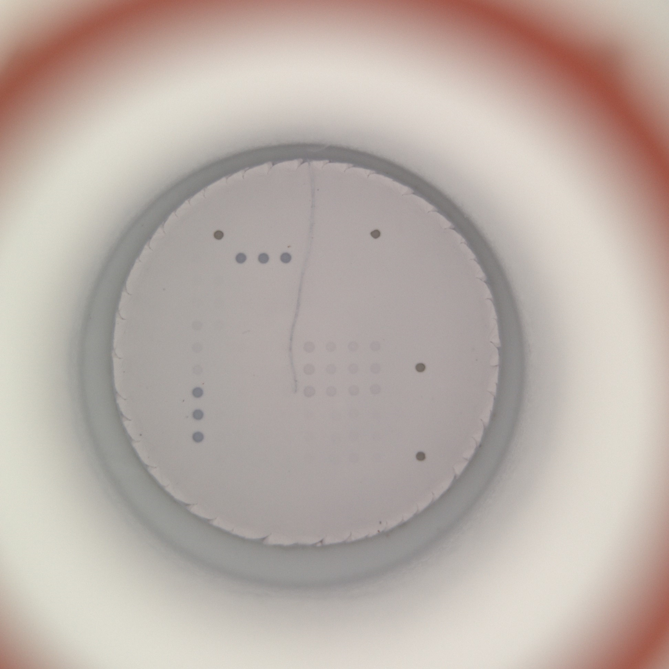

Crack, rip in membrane can cause false positivity, calibration is not possible to evaluate => samples cannot be quantified, or conjugate control is not valid
=>
Repeat the analysis – whole procces of sample preparation
Manually adjust in sw using „Enabled for analysis“ button

